Slide 1
Things to think about…
Are your fingers on the correct string?
Is your bow on the correct string?
Are you pressing down hard enough/too much?
4. Are you using enough bow? Are you using lots of bow?
Are you bowing in straight lines or not?
Are you catching different strings when you play? If so, which ones? What do you need to do?
Are your fingers in exactly the correct places?
8. Are you holding both (all) of your fingers when you play an F#?

Slide 2


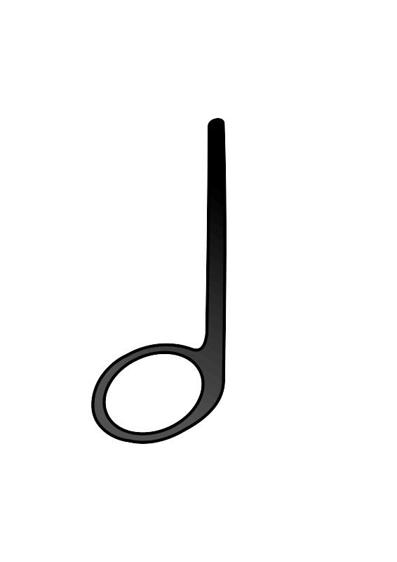

Hot Cross Buns
F# E D - | F# E D - | DDDD EEEE | F# E D -
1 D - 3 1 D - | 1 D - 3 1 D - | DDDD 1111 DDDD 1111 | 1 D - 3 1 D -
Open String part D A D - | D A D - | DDDD AAAA | D A D -
Fingerings in Green text are for Cello players

Slide 3
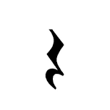
Merrily We Roll Along
F# E D E | F# F# F#__ | E E E__ | F# A A__
1 D 1 1 D 1 | 2 2__ 3 3__ | 1 1__ 1 1 1__ | A A__ A A__
F# E D E | F# F# F#__ | E E F# E | D__ * *
1 D 1 1 D 1 | 2 2__ 3 3__ | 1 1 2 1 1 1 3 1 | D__ * * D__ * *
RED = Open String Part (Harmony)
D D D D | D D D__ | A A A__ | D D D__
D D D D | D D D__ | A A A A | D___ * *

Slide 4
The Shepherd
D E F# E | D D D__ | E E E__ | F# F# F#__
D 1 2 1 D 1 3 1 | D D D__ D D D__ | 1 1__ 1 1 1__ | 2 2 2__ 3 3 3__
D E F# E | D D D__ | E E F# E | D__ * *
D 1 2 1 D 1 3 1 | D D D__ D D D__ | 1 1 2 1 1 1 3 1 | D__ * * D__ * *

Slide 5
Bavaria
D D D D | E E E__ | D E F# E | D D D__
D D D D D D D D | 1 1 1__ 1 1 1__ | D 1 2 1 D 1 3 1 | D D D__ D D D__
D D D__ | E E E__ | D D D D | D__ * *
D D D__ D D D__ | 1 1 1__ 1 1 1__ | D D D D D D D D | D__ * * D__ * *

Slide 6
Bavaria (2)
E E E E | E F# E__ | D D D D | D E D__
1 1 1 1 1 1 1 1 | 1 2 1__ 1 3 1__ | D D D D D D D D | D 1 D__ D 1 D__
D D D__ | E E E__ | D D D D | D__ * *
D D D__ D D D__ | 1 1 1__ 1 1 1__ | D D D D D D D D | D__ * * D__ * *

Slide 7


London Eye
F# F# F# 2/3 2/3 2/3 | E E E 1 1 1 | D D D D D D | A * * A * *
B - - 1 - - | A - - A - - | B - - 1 - - | A - - A - -
F# F# F# 2/3 2/3 2/3 | E E E 1 1 1 | D D D D D D | A * * A * *
B - - 1 - - | A - - A - - | D - - D - -

Slide 8
Cowboy Chorus ALL STRINGS
F# F# F#F# 2 2 2 2 | G G G G 3 3 3 3 | F# F# F# F# 2 2 2 2 | E E E E 1 1 1 1
F# F# F# F# 2 2 2 2 | G G G G 3 3 3 3 | F# F# E E 2 2 1 1 | D_ D_ D_ D_
F# F# F#F# 3 3 3 3 | G G G G 4 4 4 4 | F# F# F# F# 3 3 3 3 | E E E E 1 1 1 1
F# F# F# F# 3 3 3 3 | G G G G 4 4 4 4 | F# F# E E 3 3 1 1 | D_ D_ D_ D_

Slide 9
Strictly Tango
E - F# F# 1 - 2/3 2/3 | E - D D 1 - D D | E E F# F# 1 1 2/3 2/3 | E * * * 1 * * *
B - C# C# 1 - 2/3 2/3 | B - A A 1 - A A | B B C# C# 1 1 2/3 2/3 | B * * * 1 * * *
E - F# F# 1 - 2/3 2/3 | E - D D 1 - D D | E E F# F# 1 1 2/3 2/3 | E * * * 1 * * *
E E F# F# 1 1 2/3 2/3 | E * * * 1 * * *

Slide 10

Too Much Rosin!
GGGG * * | GGGG * * | G G A A 1 1 | G A B * 1 2/3 *
GGGG * * | GGGG * * | G G A A 1 1 | B A G * 2/3 1 G *
F# F# ED * 2/3 2/3 1D * | * * * * | F# F# ED * 2/3 2/3 1D * | * * * *
GGGG * * | GGGG * * | G G A A 1 1 | B A G * 2/3 1 G *

Slide 11






William Tell Overture
* * * * | * * * EE 11 | E EE E EE 1 11 1 11 | A B C# * A 1 2/3 *
* * * * | * * * EE 11 | E EE E EE 1 11 1 11 | A B C# * A 1 2/3 *
* * * * | * * * EE 11 | E EE E EE 1 11 1 11 | A B C# * A 1 2/3 *
* * * * | * * * EE 11 | E EE E EE 1 11 1 11 | A B C# * A 1 2/3 *
E E E * 1 1 1 * | A C# A * A 2/3 A *

Slide 12
Mary Had a Baby
DD DD E F# DD DD 1 2/3 | D - A - D 1 | DD DD E F# DD DD 1 2/3 | D B A - D 2/3 1
DD DD E F# DD DD 1 2/3 | B - A - 1 A | AB AB AF# DE A1 A1 D2/3 D1 | F# E D - 2/3 1 D
Repeat

