Slide 1

Copy Cat!
COPY: D D E E
PLAY WITH ME: E E D D G_______
COPY: A A B B
PLAY WITH ME: B B A A D_______
COPY: D D E E
PLAY WITH ME: E E D D G_______

Slide 2


Witches’ Cauldron
E E D D | E E * * | E E D D | E * * *
1 1 D D | 1 1 * * | 1 1 D D | 1 * * *
B B A A | B B * * | E E D D | E * * *
1 1 A A | 1 1 * * | 1 1 D D | 1 * * *
Two bars’ introduction. Repeat all the way through, getting faster and faster the second time.

Slide 3



Paganini!
* * AA AA * * AA AA | * * BBBB * * 1 1 1 1 | * * AAAA * * AAAA | E E * 1 1 *
* * AA AA * * AA AA | * * BBBB * * 1 1 1 1 | * * AAAA * * AAAA | E E * 1 1 *
A A A A A A A A | A * * A * * | G G G G G G G G | G * * G * *
* * BBBB * * 1 1 1 1 | * * AAAA * * AAAA | * * EE EE * * 1 1 1 1 | A A * A A *

Slide 4



Funky Monkey
Count 8 bars intro
1 2 3 4 A A B B 1 2 3 4 A A B B
FUNKY MONKEY
AA A B B 1 2 3 4 DD D E E 1 2 3 4
GROO-VY GORILLA
1 2 3 4 A A E E 1 2 3 4 E E A A
FUNKY MONKEY
First Line x 2
Second Line x 1
Third Line x 2

Slide 5
Rhythm Fever
E E D E | “1! 2! 3! 4!” | E E D * | “1! 2! 3! 4!”
1 1 D 1 | * * * * | 1 1 D * | * * * *
E E D E | “1! 2! 3! 4!” | E D E * | “1! 2! 3! 4!”
1 1 D 1 | * * * * | 1 D 1 * | * * * *
E E B B | A A B B | E E B B | A A B B
1 1 1 1 | A A 1 1 | 1 1 1 1 | A A 1 1
E E D E | “1! 2! 3! 4!” | B B A B | “1! 2! 3! 4!”
1 1 D 1 | * * * * | 1 1 A 1 | * * * *
E E D E | E___ E *
RHYTHM FEVER
Two bars’ introduction.
RED = D String PURPLE = A String
1 1 D 1 | 1___ 1 *

Slide 6

Tiptoe, boo!
G A G A G 1 G 1` | G A D * G 1 D * | G A G A G 1 G 1 | G A D * G 1 D *
G A G A G 1 G 1 | G A G * G 1 G * | D D D D D D D D | G * * * G * * *
D E D E D 1 D 1 | D E A * D 1 A * | D E D E D 1 D 1 | D E A * D 1 A *
D E D E D 1 D 1 | D E D * D 1 D * | A A A A A A A A | D * * * D * * *

Slide 7
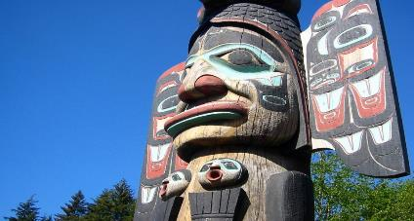
Totem Pole
E E B B A A B B
E E B B A A B *
E E B B A A B B
E E B B A B E *

Slide 8
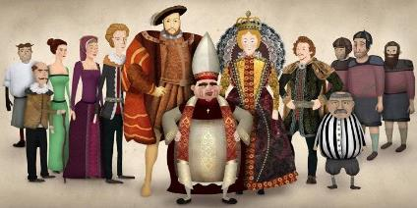
Tudor Pageant
B B B A B B B D
E________ D D E________ D D
B B B A B B B D
E________ D D G________

Slide 9

Saraswati
A A B B | E E E *
A A B B | E E E *
E E A A | B B E *
E E A A | B B A *

Slide 10
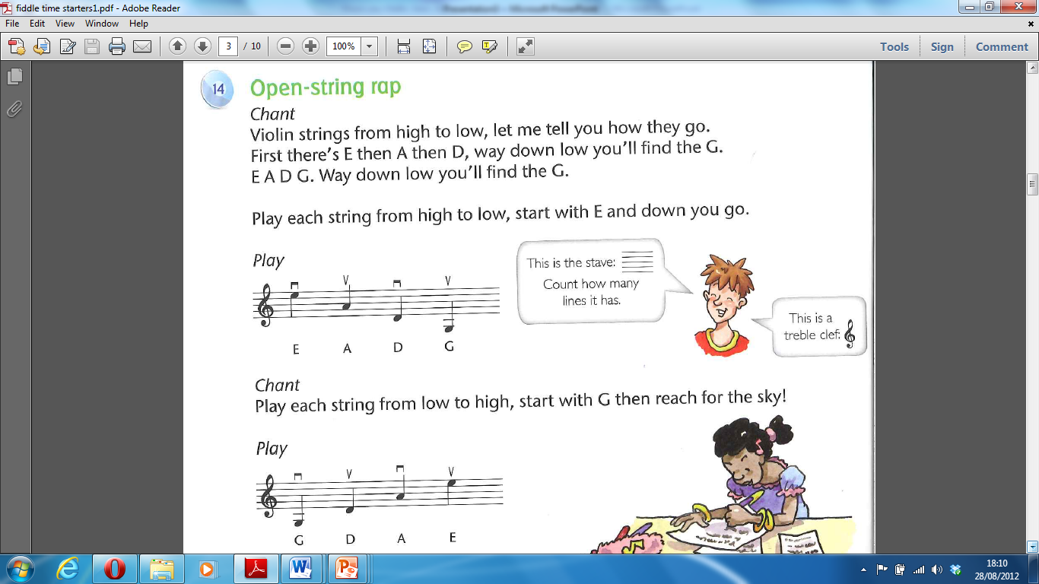
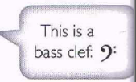
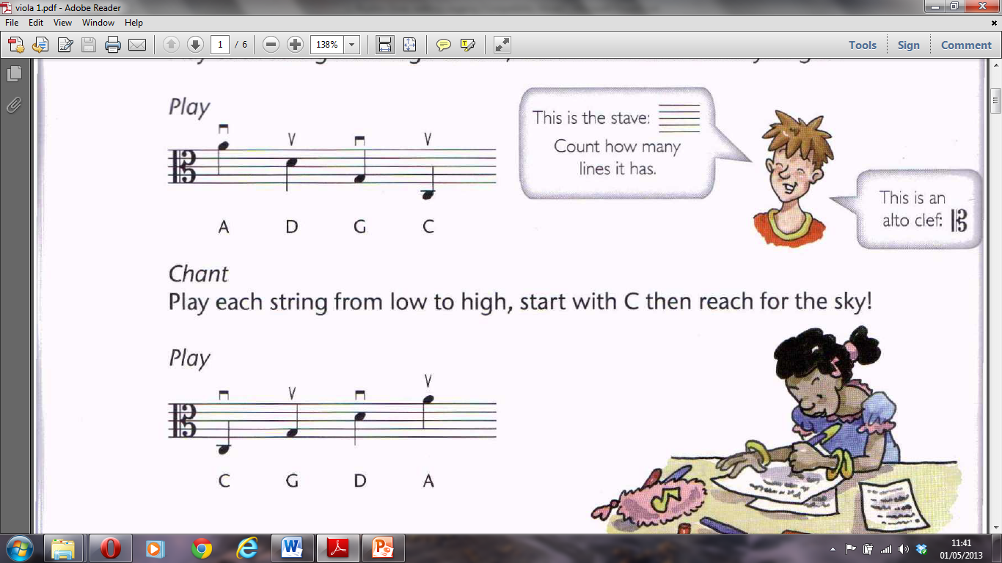
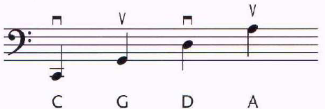
Notes on the Stave
The violin:
The violas:
The cellos:
Notes:
Track 14
10

Slide 11
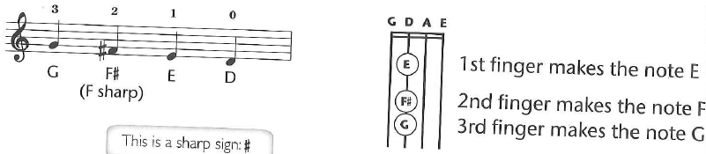
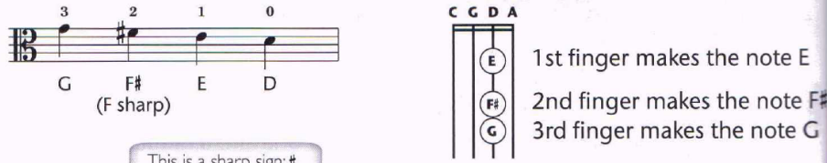
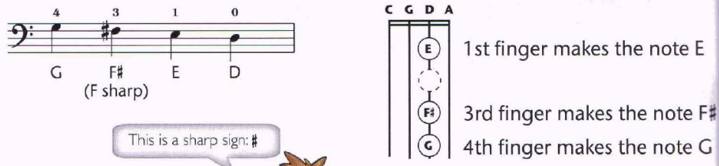
D String Notes
violin
#
viola
cello
Notes:
Track 37
11

Slide 12
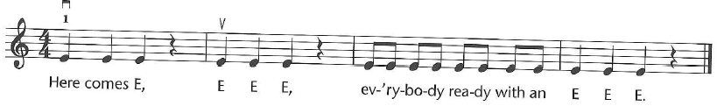
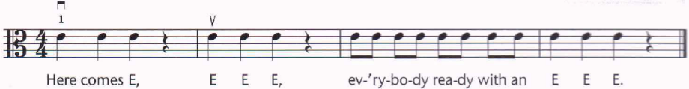
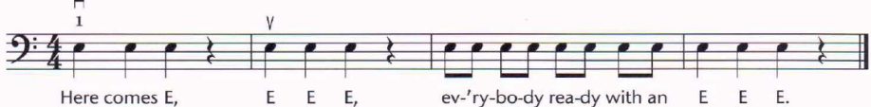
Here comes E
violin
viola
cello
Notes:
starlight
12

Slide 13
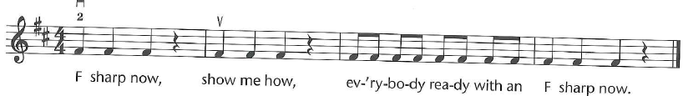
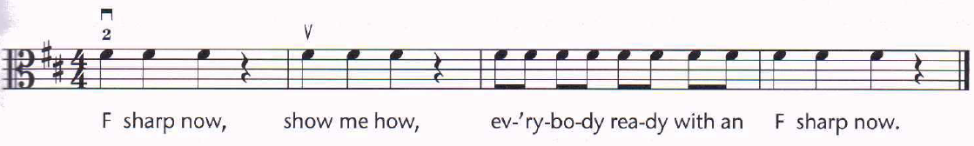
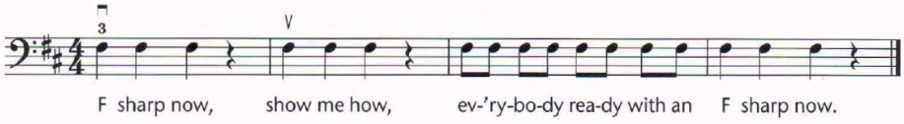
F sharp now
violin
viola
cello
Notes:
Venice and vivaldi
13

Slide 14
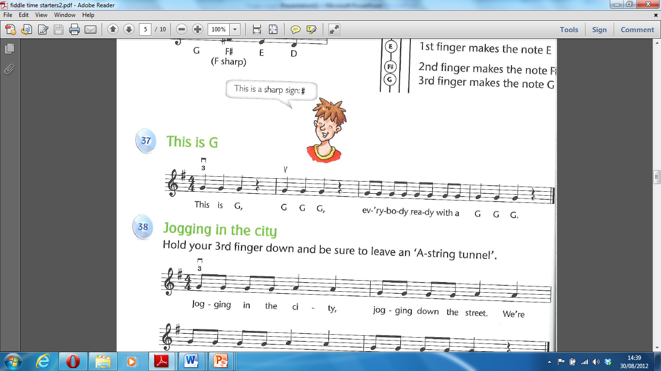
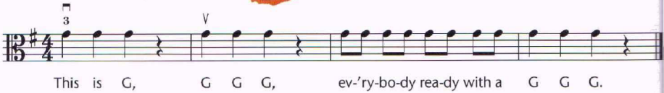
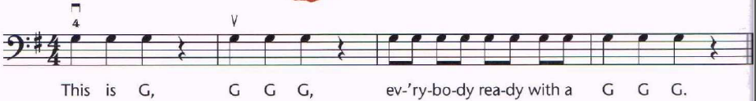
This is G
violin
viola
cello
Notes:
Jogging in the city
Perfect match
14

